Slide 1
Graph Databases
Jose Andrés Campos Castro
Roberto Gutiérrez Sánchez

Slide 2
Agenda
Graphs
Types of graphs.
History of Graph Databases.
DBMS Examples.
Graph Databases in Neo4j.
Example.

Slide 3
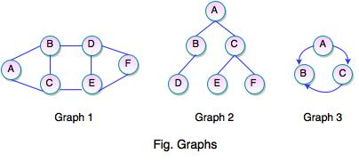
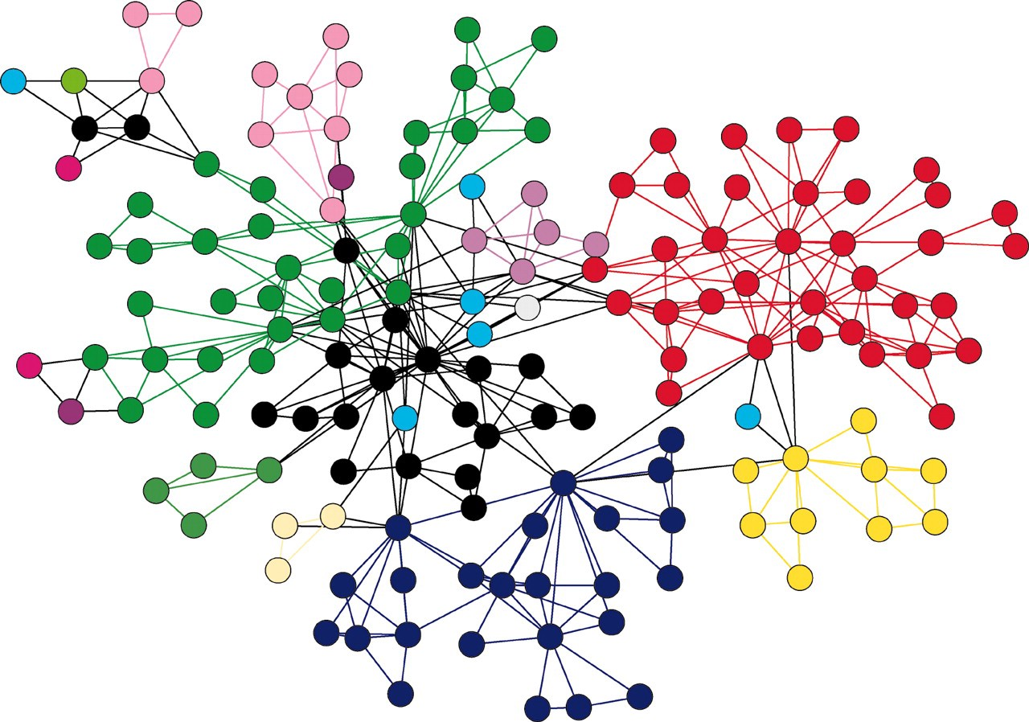
Graphs

Slide 4
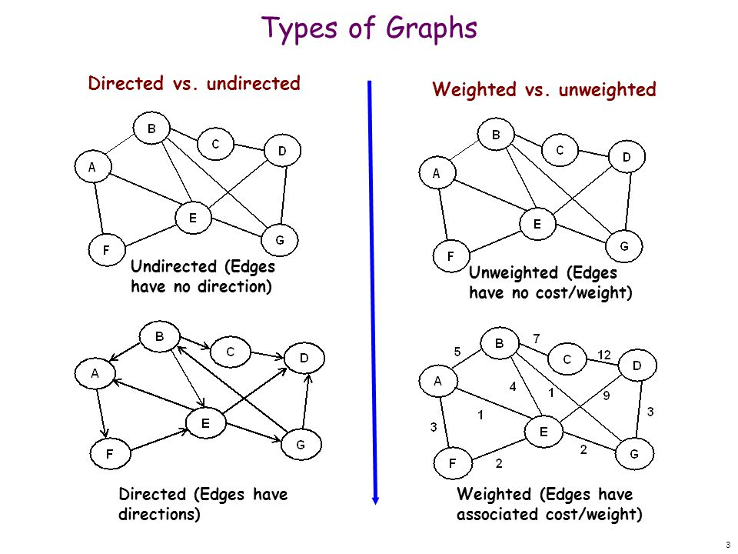
Types of Graphs

Slide 5
History of Graph Databases
70’s → Tabular Databases
80’s → Relational Databases
90’s → NoSQL.
BASE | ACID
Basic Availability | Atomic: Everything in a transaction succeeds or the entire transaction is rolled back.
Soft-state | Consistent: A transaction cannot leave the database in an inconsistent state.
Eventual consistency | Isolated: Transactions cannot interfere with each other.
 | Durable: Completed transactions persist, even when servers restart etc.

Slide 6
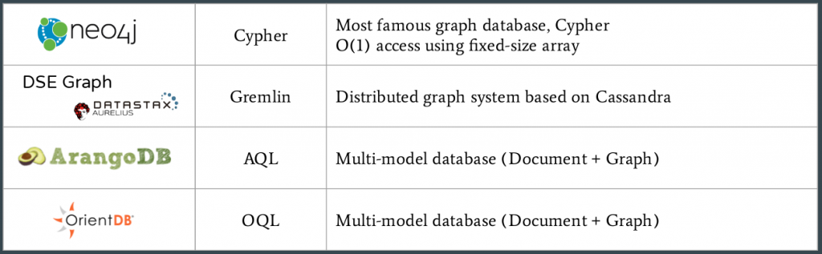
DBMS Examples.

Slide 7
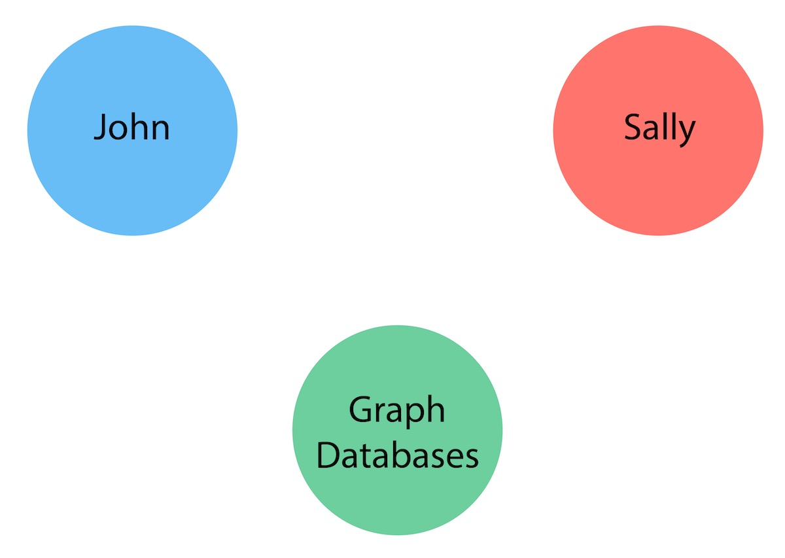
Graph Databases in Neo4j.
Nodes
Most basic entity
Can have labels
Represent objects
Labels for roles

Slide 8
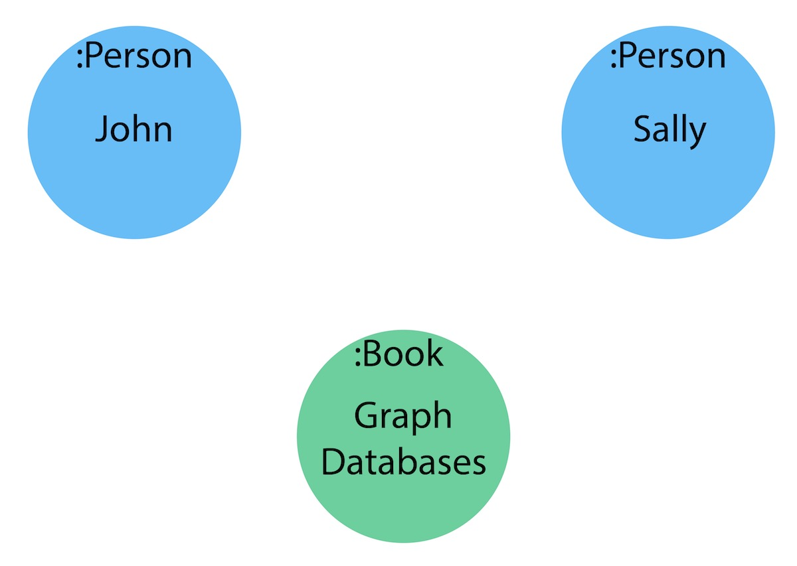
Graph Databases in Neo4j.
Labels
Group nodes
More efficient
Used in entities
Normally used for objects
CamelCase practice

Slide 9
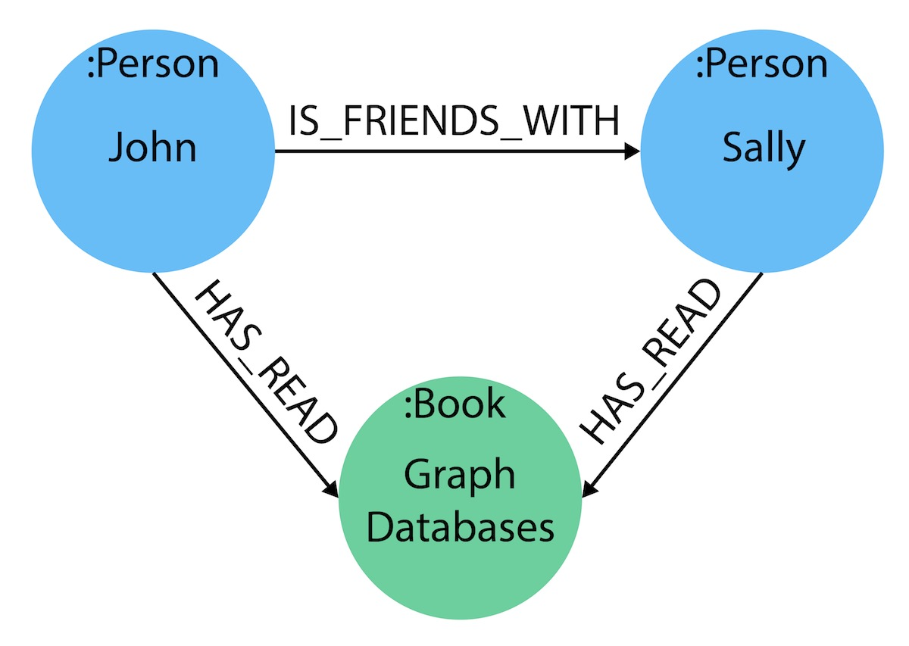
Graph Databases in Neo4j.
Relationships
Connection between nodes
Source and target
Directed and not-directed
Represent actions/verbs

Slide 10
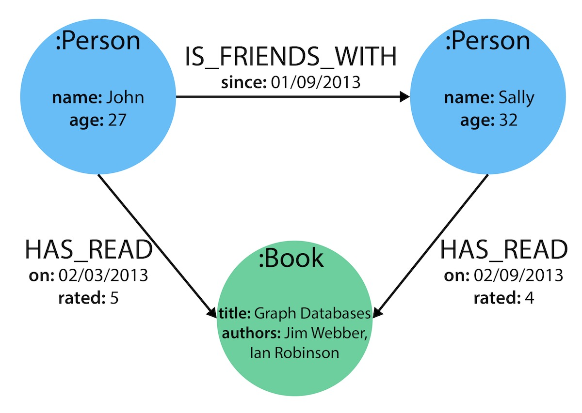
Graph Databases in Neo4j.
Properties
Attributes
Key and Value
Used in nodes and relations
Store information
int, float, string, etc

Slide 11
Example
https://github.com/campos-97/GraphDBExample
https://neo4j.com/download/

Slide 12
Bibliography
"History of Databases and Graph Database - Bitnine Global Inc.", Bitnine Global Inc [Online]. Available: https://bitnine.net/blog-graph-database/history-of-databases-and-graph-database/. [Accessed: 7- Oct- 2018].
"Impossible Is Nothing: The History (& Future) of Graph Data [GraphConnect Recap] - Neo4j Graph Database Platform", Neo4j Graph Database Platform. [Online]. Available: https://neo4j.com/blog/history-and-future-of-graph-data/. [Accessed: 7- Oct- 2018].
"Relational Databases vs. Graph Databases: A Comparison", Neo4j Graph Database Platform .[Online]. Available: https://neo4j.com/developer/graph-db-vs-rdbms/. [Accessed: 7- Oct- 2018].
J. Cook, "ACID versus BASE for database transactions", Johndcook.com. [Online]. Available: https://www.johndcook.com/blog/2009/07/06/brewer-cap-theorem-base/. [Accessed: 7- Oct- 2018].

